Slide 1
Data Warehousing & Visualization
Georgios-Konstantinos Vlassis
Christos Vlassis

Slide 2
Dataset
The dataset was found on Kaggle
https://www.kaggle.com/datasets/mastmustu/insurance-claims-fraud-data?select=insurance_data.csv
Information from Insurance Company events
Contains 3 tables
Employee data table
Vendor data table
Insurance data table (transactional)

Slide 3
Data Information
Approximately 10000 rows with 55 columns amongst the 3 tables
We have information about accidents, customers, employees and vendors
Revenue Analysis can’t be done with these data, because we don’t have the necessary information
Transaction | Dates | Customer Info | Agent Info | Vendor Info | Incident Info

Slide 4
ETL
Extract
A left join was made from the Employee and Vendor tables to the Transaction table
We removed some information such as addresses lines, SSNs and Names as they provide no value to our analysis
Transform
For the dimensions, we replaced any NULL values with N/A
Generally, there were no major issues with quality of the data

Slide 5
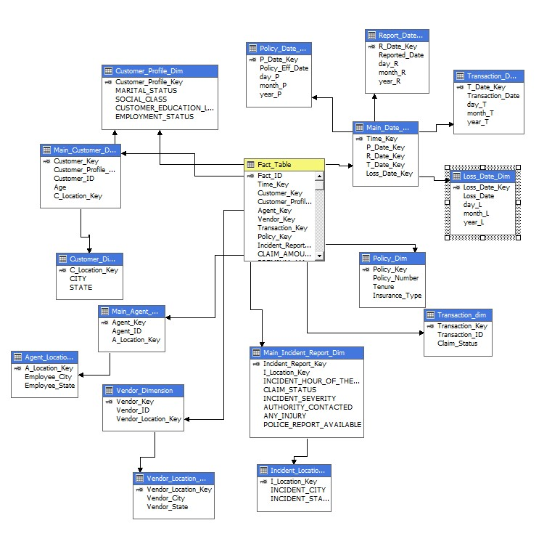
Data Warehouse Schema

Slide 6
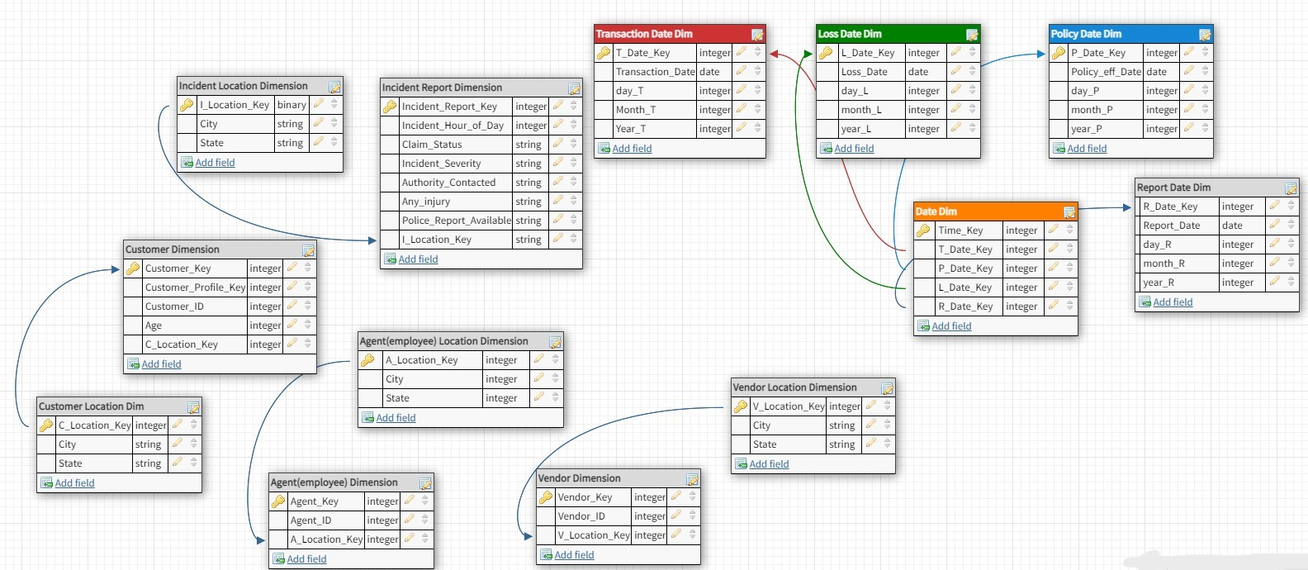
Tricky Parts

Slide 7
Tableau
The aforementioned data were fed to Tableau in order to create the Dashboards
Diagrams and Maps as visualizations with the input data (more intuitive)
Metrics for general insight of the situation (more direct)
Filters for Date, State and Insurance Type to slice the data (and some more)

Slide 8
Dashboards
They were created with a real business scenario in mind
Contain necessary information for the person overlooking specific tasks
Two Dashboards/Reports were created
Six Visualizations and Four Metrics in each
Not overwhelming data, but useful data

Slide 9
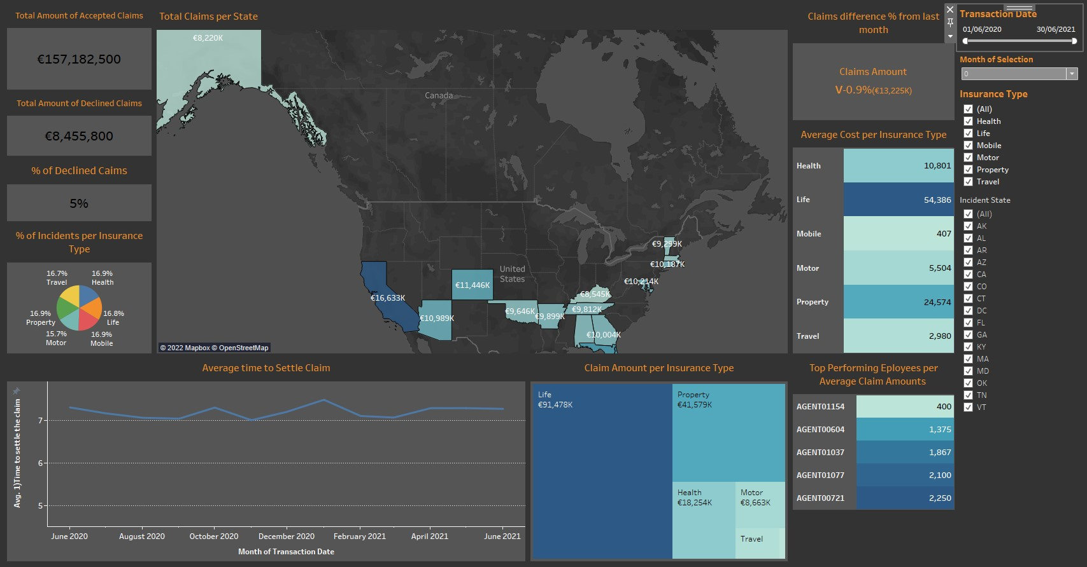
Claims Report
Financial/Performance Information
Financial/Sales Officer

Slide 10
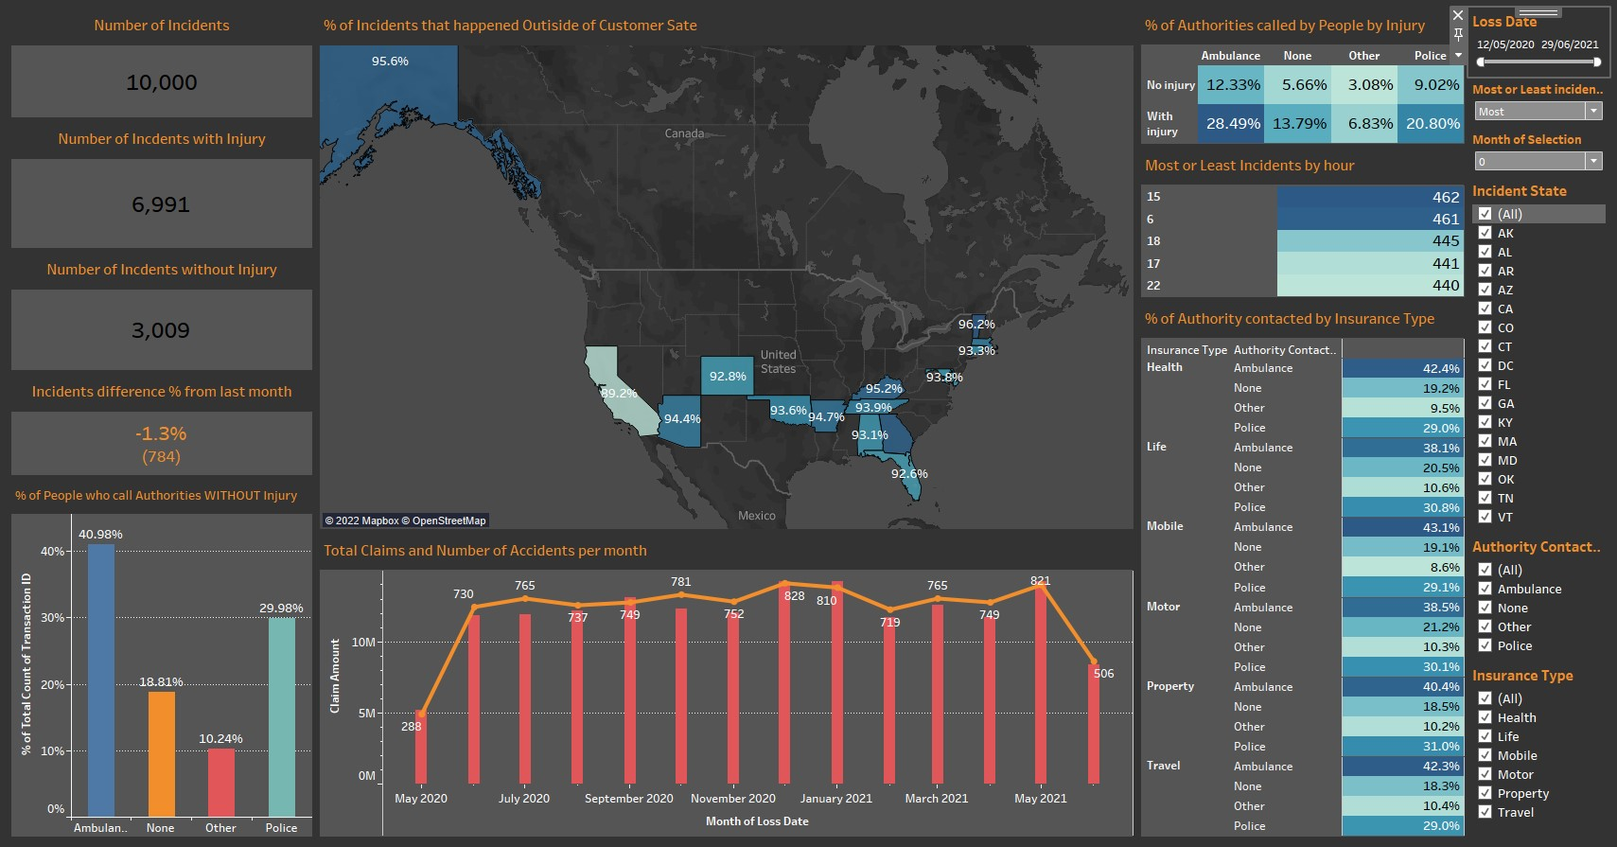
Incidents Report
Incidents Information
Operations/Sales Officer

Slide 11

Thank you very much
and

